Slide 1


The Queen’s Problem

Slide 2

Big O Notation
Big O notation provides a way of assessing the time complexity of an algorithm.
It is written in the form O(n) which would imply that the algorithm in question has linear time complexity, or that the time it would take to run is directly proportional to the size of the data on which it operates

Slide 3
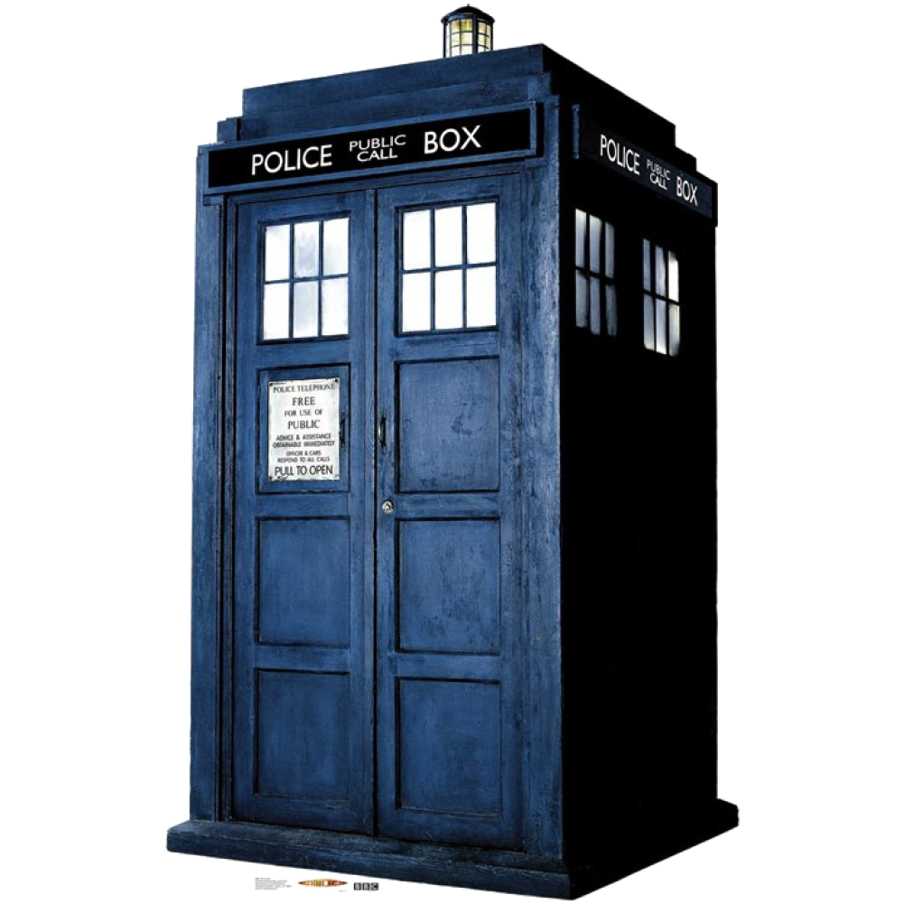
Types of time complexity
O(1) | Constant time
O(n) | Linear time
O(n^2) | Quadratic time
O(n^3) | Cubic time
O(log(n)) | Logarithmic time

Slide 4

But how do we actually determine the time complexity of an algorithm?

Slide 5
Algorithm #1
Set largestNumber to first number in array
Set index to 1
Start loop
if value of next array element is more than largestNumber
set largestNumber to value of next array element
end if
add 1 to index
Until index is more than size of array
Notes:
Finds the Maximum value of an array
We can do step counting
1 - 2 steps, looking up a value and assigning that value
2 - 1 step, setting a value
3 - no steps
4 - 2n steps - for each value you need to get the value and then compare it to the largest number
5 - 2n steps - Worst case, for every n we will need to look at the value we have and then update the largest number
6 - no steps
7 - n steps - each part of loop we need to add 1
8 - n steps - need to check the curent index against the size of the array
so time complexity is 3 + 6n
With Big O notation though we are concerned with what will happen as n gets really big. In this case, the 3 becomes irrelevant as does the 6 and so we get O(n) - linear time

Slide 6
Algorithm #2
Set numberToCount to the required value
Set index to 0
Set occurrences to 0
Start loop
if value of array element = numberToCount then
add 1 to occurrences
end if
Add 1 to index
Until index is more then the size of the array
Display the number of occurrences
Notes:
Counts how many times a value appears in an array
O(n)

Slide 7
Algorithm #3
Set Duplicate to False
for all the elements of the first row
for all the elements of the second row
if a value in the first row is the same as a value in the second row
Set Duplicate to True
end
report if there are duplicates or not
Notes:
Checks an array for duplicates
O(n^2)

Slide 8
Algorithm #4
define Factorial(n)
if n is equal to 1
return 1
otherwise
return n*factorial (n-1)
Notes:
Caculates the factorial of a number
O(n)

Slide 9
Algorithm #5
def binarySearch( A, n, value ):
if n = 1:
if A[ 0 ] = value:
return true
else:
return false
if value < A[ n / 2 ]:
return binarySearch( A[ 0...( n / 2 - 1 ) ], n / 2 - 1, value )
else if value > A[ n / 2 ]:
return binarySearch( A[ ( n / 2 + 1 )...n ], n / 2 - 1, value )
else:
return true
Notes:
Binary Search
0th iteration: n
1st iteration: n / 2
2nd iteration: n / 4
3rd iteration: n / 8
...
i^{th} iteration: n / 2^{i}
...
last iteration: 1
assuming that this is possible without having to worry about if we have odd numbers occuring and we do get down to 1
we end up with
1=n/2^i
n=2^i
i=log2(n)
therefore we can say that in order to carry out this algorithm it will be O(log(n))

Slide 10
Algorithm #6
def merge( A, B ):
if empty( A ):
return B
if empty( B ):
return A
if A[ 0 ] < B[ 0 ]:
return concat( A[ 0 ], merge( A[ 1...A_n ], B ) )
else:
return concat( B[ 0 ], merge( A, B[ 1...B_n ] ) )
Notes:
Merge sort
Puts two ordered lists together in order
O(n)

Slide 11
Algorithm #7
def mergeSort( A, n ):
if n = 1:
return A # it is already sorted
middle = floor( n / 2 )
leftHalf = A[ 1...middle ]
rightHalf = A[ ( middle + 1 )...n ]
return merge( mergeSort( leftHalf, middle ), mergeSort( rightHalf, n - middle ) )
Notes:
Merge sort
Puts two ordered lists together in order
O(n)

Slide 12
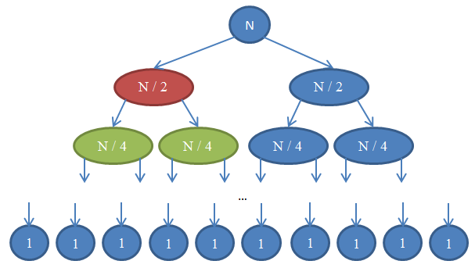
Algorithm #7
def mergeSort( A, n ):
if n = 1:
return A # it is already sorted
middle = floor( n / 2 )
leftHalf = A[ 1...middle ]
rightHalf = A[ ( middle + 1 )...n ]
return merge( mergeSort( leftHalf, middle ), mergeSort( rightHalf, n - middle ) )
Notes:
Merge sort horizontally
Puts two ordered lists together in order
therefore O(n) horizontally
but working downwards we are doing something similar to what binary sort did, halving the size each time until we get to 1
So working vertically time complexity is O(log(n))
This means in total the complexity of this algorithm is O(n*log(n))
which is still better than O(n^2)

Slide 13
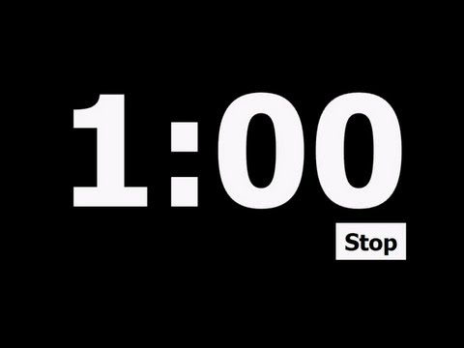
Big O Notation
Put the following running times in order of best to worst
O(n)
O(n²)
O(log(n))
O(nlog(n))
O(n!)
O(n³)
O(2^{n})
O(1)

Slide 14
Big O Notation
O(1)
O(log(n))
O(n)
O(nlog(n))
O(n²)
O(n³)
O(2^{n})
O(n!)

Slide 15
Big O Notation - run times
n | O(1) | O(log(n)) | O(n) | O(nlog(n)) | O(n²) | O(n³) | O(2^{n}) | O(n!)
10 | 1 | 3.3 | 10 | 33 | 10² | 10³ | 10³ | 3.6 x 10⁶
10² | 1 | 6.6 | 10² | 660 | 10⁴ | 10⁶ | 1.3 x 10³⁰ | 9.3 x 10¹⁵⁷
10³ | 1 | 10 | 10³ | 10⁴ | 10⁶ | 10⁹ | who cares
10⁴ | 1 | 13 | 10⁴ | 1.3 x 10⁵ | 10⁸ | 10¹² | who cares

Slide 16
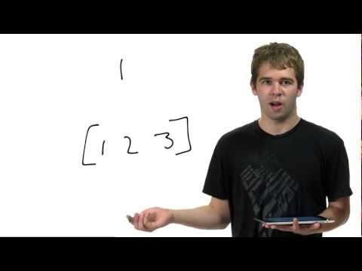

Slide 17
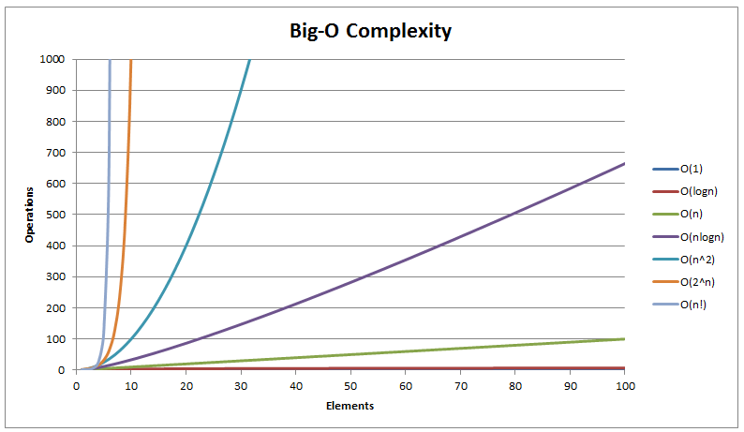

Slide 18
P vs Np
P problems are solvable in polynomial time
NP problems are verifiable (yes or no) in polynomial time

Slide 19
P vs Np
NP complete problems are the NP problems that it is possible to reduce (or convert) any other NP problem into in polynomial time
NP hard problems are problems that are at least as difficult as NP problems but don’t necessarily need to be verifiable in polynomial time

Slide 20
